Slide 1

TEXT CLASSIFICATION
Name:- Anirudh Rana
University Roll No. :- 2118225
Mentor Name :- Ms. Rishika Yadav
Designation :- Assistant Professor

Slide 2
Introduction
Text classification using news categorization is a method of automatically organizing news articles into predefined categories, such as business, entertainment, technology, and medical, based on the content of the article. This process is commonly used in natural language processing (NLP) to help news organizations and search engines quickly and accurately sort and categorize large amounts of news articles.
News categorization is a widely used technique in natural language processing to classify news articles into different categories such as business, entertainment, technology, and medical. The task is challenging as it requires understanding the context and meaning of the text, which is a complex task for machines. In this project, we aim to develop a text classification model for news categorization using the Multinomial Naive Bayes algorithm and Tf-idf feature extraction method.

Slide 3
The dataset we used for this project is the UCI News Aggregator dataset, which contains over 420,000 news articles from various sources. The dataset is preprocessed and cleaned to remove missing values and unnecessary columns. The model is trained on 80% of the dataset and tested on the remaining 20%. The performance of the model is evaluated using various metrics such as accuracy, precision, recall, and F1-score. Additionally, we also provide a user interface to input a new news article and predict its category. The goal of this project is to provide a reliable and efficient model for news categorization.
Overall, the goal of news categorization is to build a system that can automatically assign relevant categories to news articles, making it easier for readers to find and consume the news that is most relevant to them. This can be useful for news organizations and media companies, as well as for search engines and other applications that rely on large collections of news articles.

Slide 4
Methodology
Data
Collection
1
6
2
Model Training
and
Evaluation
Including
Tools
5
3
Features
Extraction
Including
Libraries
4
Data
preprocessing

Slide 5
We used the UCI News Aggregator dataset which contains over 420,000 news articles from various sources. We removed missing values and unnecessary columns such as ID, URL, PUBLISHER, HOSTNAME, and TIMESTAMP. We also replaced the short form of the categories with their full form. This step is important to ensure that the dataset is clean and ready to be used for training and testing the model.
We used Tf-idf (term frequency-inverse document frequency) which is a commonly used method for text classification. Tf-idf assigns a weight to each word in a document based on its frequency in the document and its rarity in the dataset. It helps to identify the most important words in a document, which are useful for classification.
We split the dataset into training and testing sets. We used a 80-20 split, with 80% of the data used for training and 20% used for testing. This step is important to ensure that the model is trained on a large dataset and evaluated on a smaller dataset for unbiased results.

Slide 6
The next step is to train the model using the Multinomial Naive Bayes algorithm. The Naive Bayes algorithm is a simple but powerful algorithm for text classification. It is based on Bayes theorem, which states that the probability of a hypothesis (class) given the evidence (features) is proportional to the probability of the evidence given the hypothesis. The Multinomial Naive Bayes algorithm is used for discrete data such as text data.
After training the model, we test it on the testing dataset. The testing dataset is used to evaluate the performance of the model by comparing the predicted labels with the actual labels. We used several metrics such as accuracy, precision, recall, and F1-score to evaluate the performance of the model.
Finally, we provide a user interface to input a new news article and predict its category. We use the trained model to predict the category of the new news article. This step is important to provide a way for users to test the model and see how it performs on new data.

Slide 7
Result
The project aimed to classify news articles into different categories using a Multinomial Naive Bayes model. The dataset used was the UCI News Aggregator dataset, which contains news articles from various sources, and the categories include business, entertainment, technology, and medical.
The dataset was preprocessed to remove missing values, and unnecessary columns such as ID, URL, PUBLISHER, HOSTNAME, and TIMESTAMP. The dataset was then split into training and testing sets in a ratio of 80:20.
The TfidfVectorizer class was used to extract features from the text data, and the training data was used to fit the vectorizer. The extracted features were then used to train the Multinomial Naive Bayes model.
The trained model was then used to make predictions on the test data, and the performance of the model was evaluated using metrics such as accuracy, precision, recall, and f1-score.
In terms of the pie chart, it shows the distribution of news articles in each category. The pie chart shows that most of the articles belong to the business category, followed by technology, medical and entertainment.

Slide 8
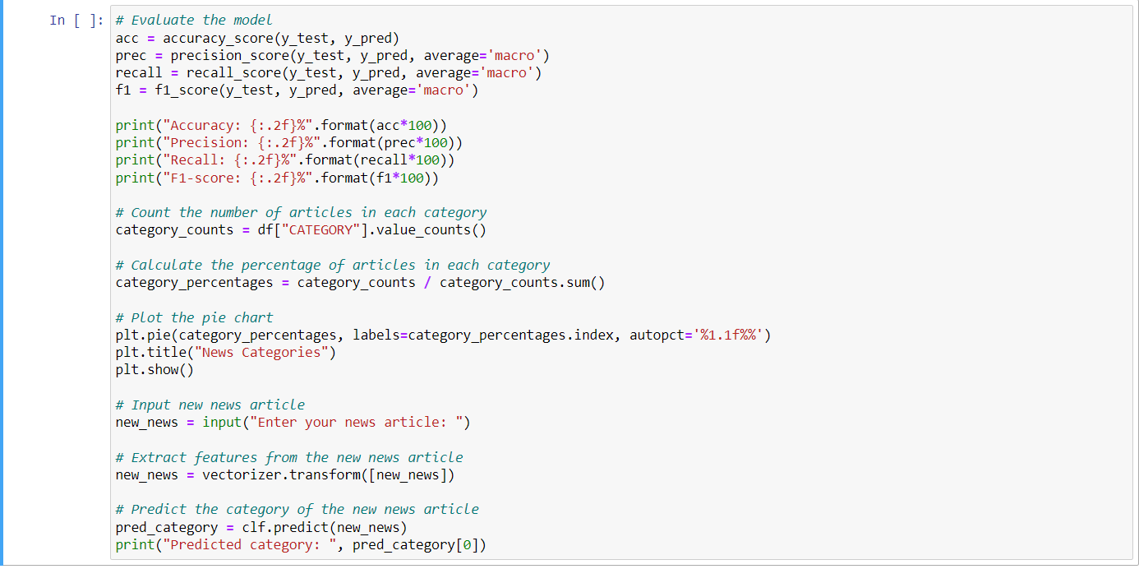
Code block for model evaluation and prediction

Slide 9
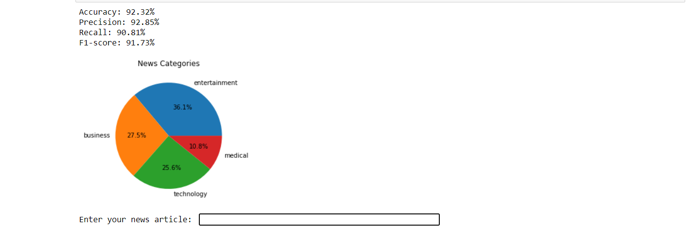
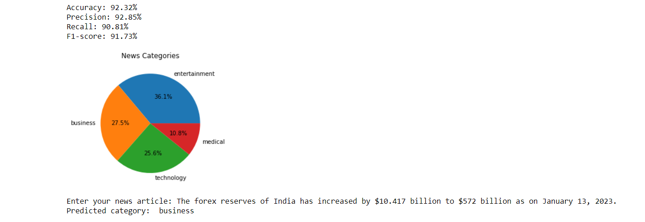
Output for model evaluation and prediction
User input for news article prediction

Slide 10
Conclusion
In conclusion, the project has successfully implemented a text classification model using a Multinomial Naive Bayes algorithm on the UCI News Aggregator dataset.
The results show that the model achieved an accuracy of 92.32%, precision of 92.85%, recall of 90.81%, and f1-score of 91.73%. These results indicate that the model performed well in terms of accuracy, precision, and recall. However, there is still room for improvement, and the model's performance could be further enhanced by implementing other algorithms such as logistic regression and experimenting with different feature extraction techniques.

